Slide 1



Fabric Defect Detection System
reporter：eleventh team
time：2023.3.29

Slide 2
CONTENTS
Project Outline
Project Team Organization
01
02
Project development plan
Project Risk
03
04

Slide 3
Project Outline
01

Slide 4
Project Outline
Background
Project overview
Technical adavangate analysis of the project
Deliverable results
Artificial intelligence is a strategic emerging industry in China.
This project aims to complete an online fabric defect detection system.
Currently, both industry and academia have do a lot of research on generation models and target detection models, and have achieved excellent performance.
The final contents of this system mainly include: system’s source code, model’s source code, trained model files, project plans, technical documents, user manuals, etc.

Slide 5

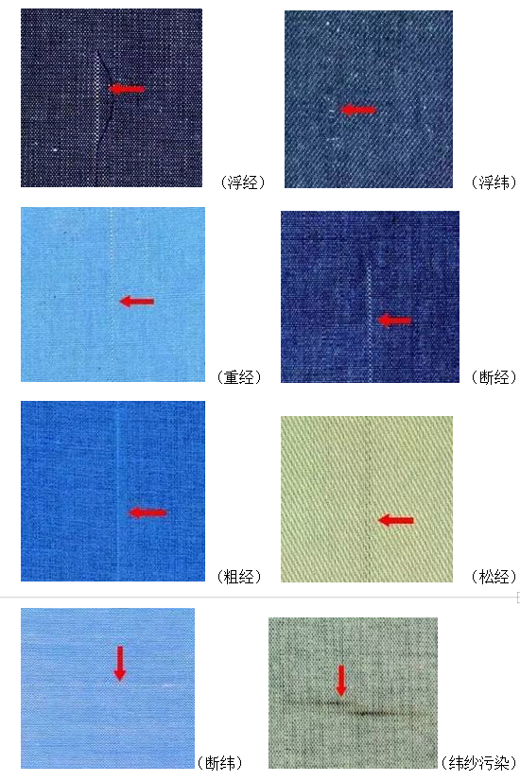
Project Outline
Project devlopment environment
The development environment of this project is four PC.
Project acceptance method
All content of the system will be submitted to GitHub for teachers to check and the system will be introduced through a presentation in the last week.

Slide 6
Project team organization
02

Slide 7
Project Team Organization
Organization structure
Structure
the project called “fabric-defect-detection system” is developed by our team.
Division of Labor
Labor
There are four members in the team. As mentioned above, the core function of the project is defect detection
Implementation
Implementation and communication
In terms of project implementation and communication

Slide 8
Project development plan
03

Slide 9
Milestone setting
Week 3
Week 4
Main work:Making team
Milestone: Team leader submits team list.
Main work: Selecting project.
Milestone: Team leader submits the project and a brief description on the online document.
Week 5,6
Week 7
Main work: Writing the project plan.
Milestone: Team leader submits the project plan at week 7.
Main work: Learning deep learning.
Milestone: Everyone should submit a report about what you have learned in this week.
Week 8
Week 9
Main work:Learning the generative model and detection model
Milestone: Team members should submit their own work in this week.The member who is responsible for the model should submit a demo.
Main work: Building the model
Secondary work: Learning the knowledge
Milestone: Team members should submit their own work in this week.The member who is responsible for the model should submit the model.This model can be incomplete,but it must be used to solve the problem we propose.

Slide 10
week10
Milestone setting
week11
Main work: Improving the model
Secondary work: Learning the knowledge
Milestone: Team members should submit their own work in this week.The member who is responsible for the model should submit the relatively complete model.
Main work: Learning how to develop a system.
Secondary work: Improving the model.
Milestone: Everyone should submit a report about what you have learned in this week.If start programming, member should submit the source code.If someone improves the model ,he should submit it on the GitHub.
week12、13
Main work: Developing the system.
Secondary work: Improving the model.
Milestone: Team members should submit their own work in this week.The member who is responsible for the system should submit the source code.If someone improves the model ,he should submit it on the GitHub.
week14
Main work: Testing the system.
Secondary work: Improving the model.
Milestone: Team members should submit their own work in this week.The member who is responsible for the testing should submit the test document.If someone improves the model ,he should submit it on the GitHub.
week15
Main work: Finishing the system.
Milestone: Team members should submit their own work in this week.The team should merge the branches and submit the final system.
week16
Main work: Report the system.
Milestone: Team members accept the check.

Slide 11
Project Risk
04

Slide 12
Project Risk
Risk Type | Risk | Solution
schedule risk | Unable to complete due to time constraints | Membershould fully consider various potential factors and make plans.Breakdown of tasks should be indetail.Members should strictly follow the project plan.
Technical risks | Unable to builda robust model due to the hardware performance | The performance of the model can be allowed to be weak，but it must be able to complete corresponding tasks.
Human Resources Risk | Members cannot complete this week's task due to special reasons. | Members need to notify other members in advance, and other membersare responsible for completing the module.

Slide 13
Thank you for you watching
reporter：eleven team
time：2023.3.29

